Slide 1
Findings Summary:
Most common landing page elements include
1. Zip code submit
2. Contact number
3. Lifestyle image
Orange is the widely used color for the CTA button, with term “Quote” being used in 63% of button verbiage.
Content on pages are more so geared to provide helpful/resourceful information about health insurance in general, versus listing brand-specific benefits/features.
CTA action is located on the right side of the page for half of the analyzed pages

Slide 2
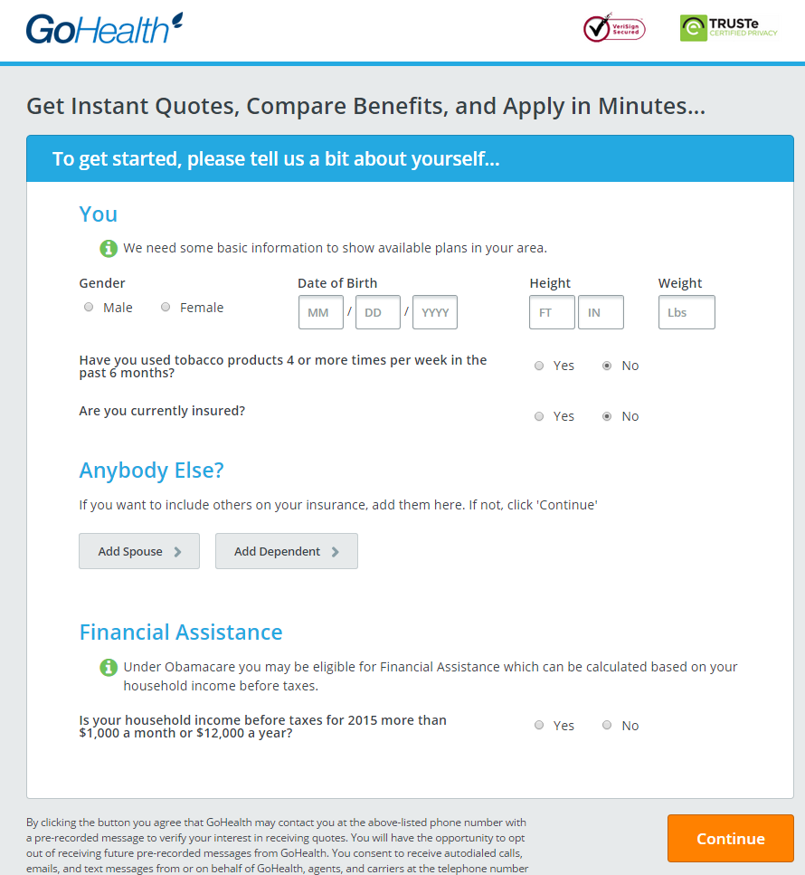

GoHealthInsurance.com

Slide 3

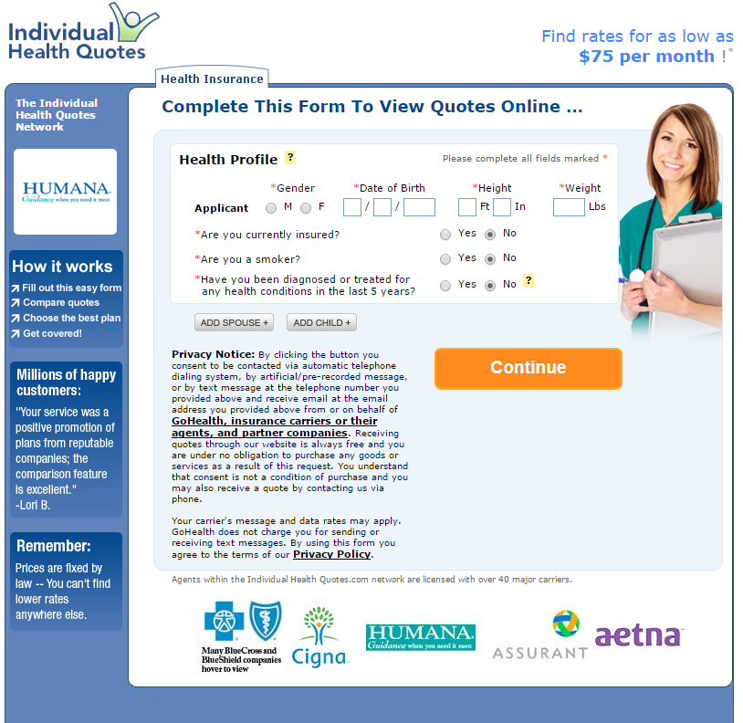
IndividualQuotes.com

Slide 4
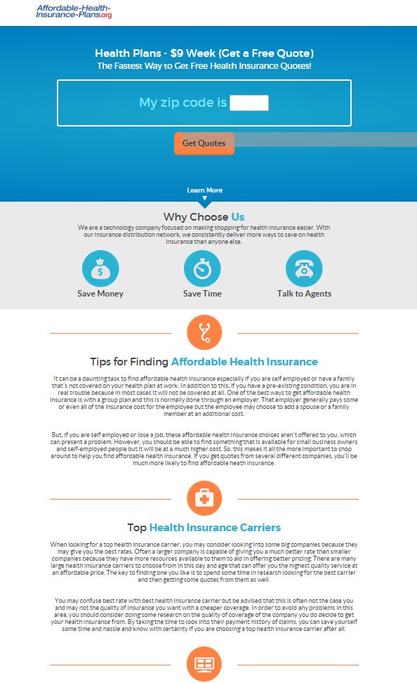
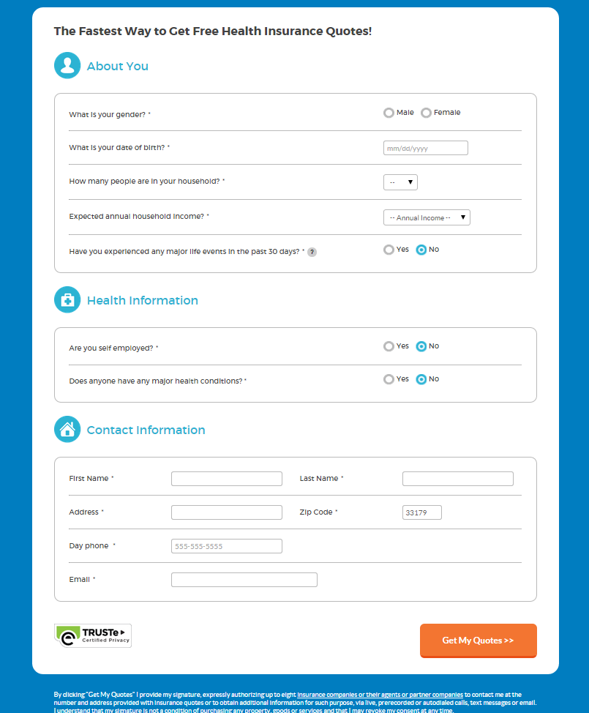
affordable-health-insurance-plans.org/

Slide 5

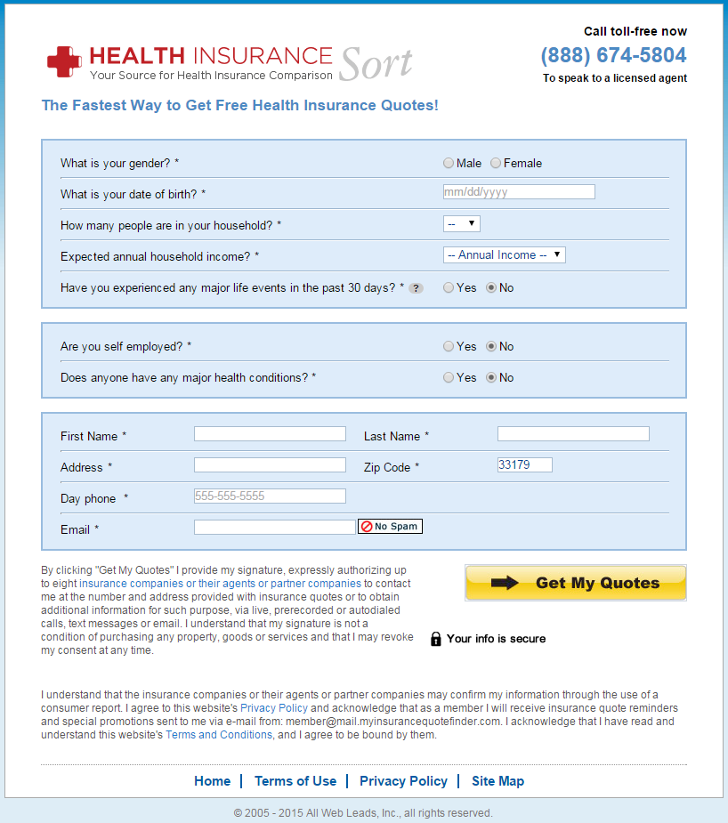
healthinsurancesort.com

Slide 6
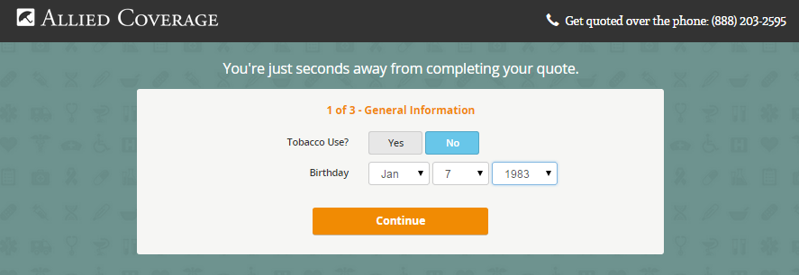
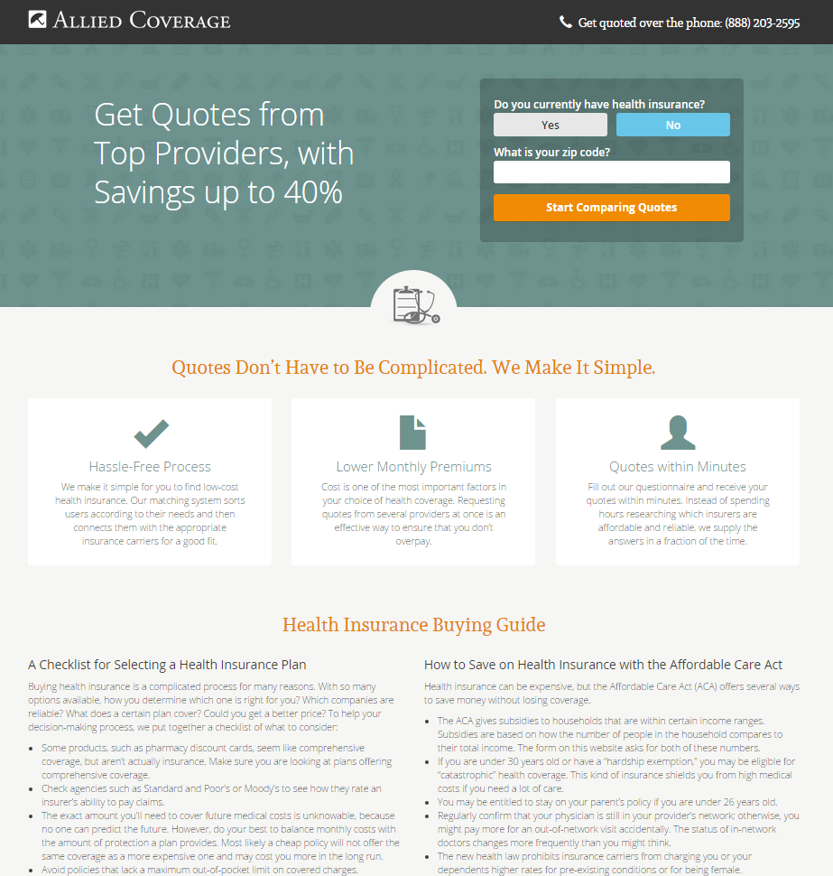
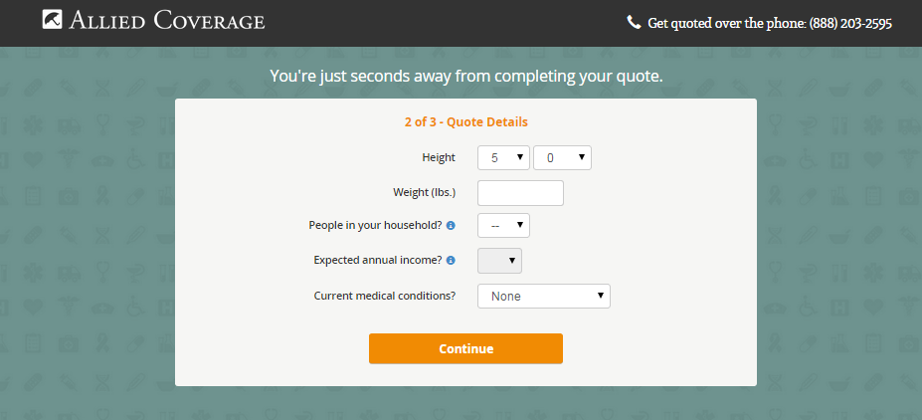
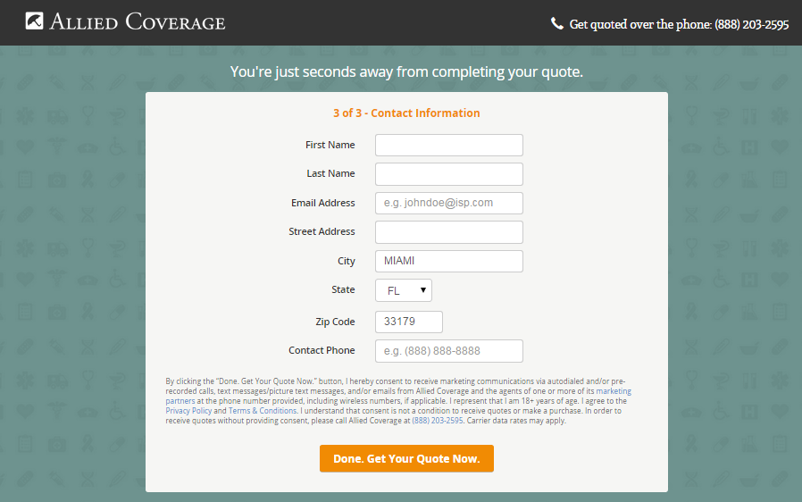
alliedcoverage.com

Slide 7
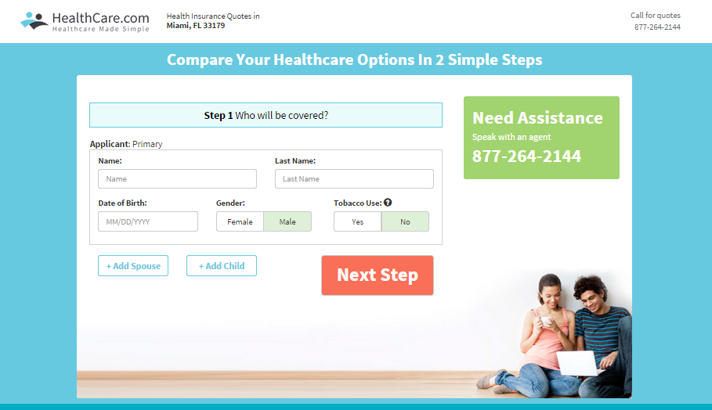
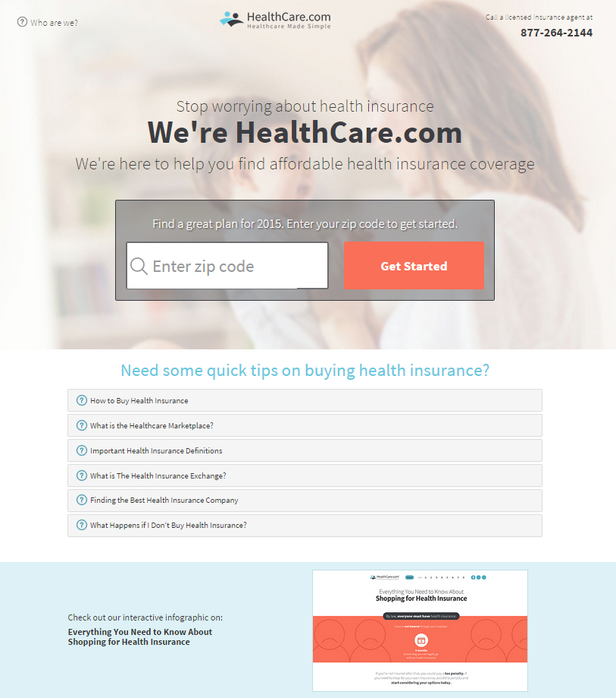
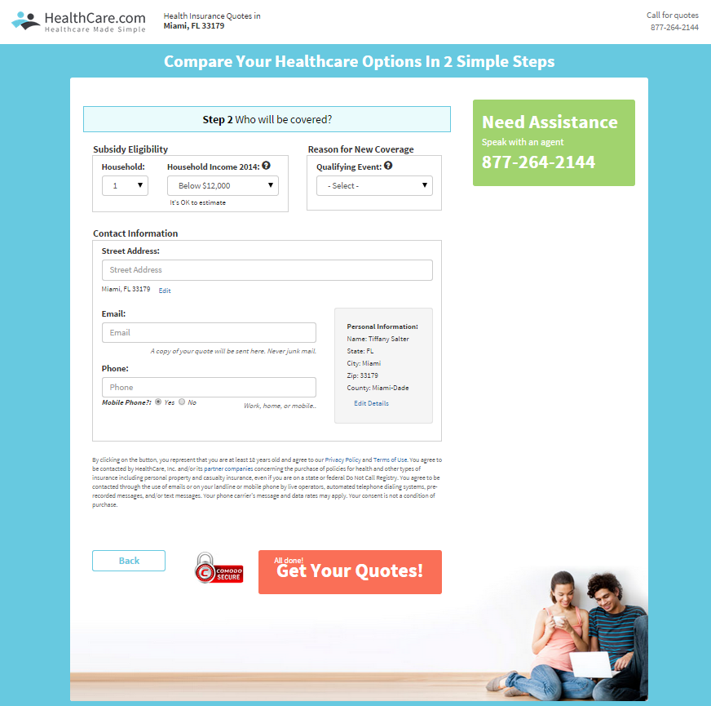
healthcare.com

Slide 8
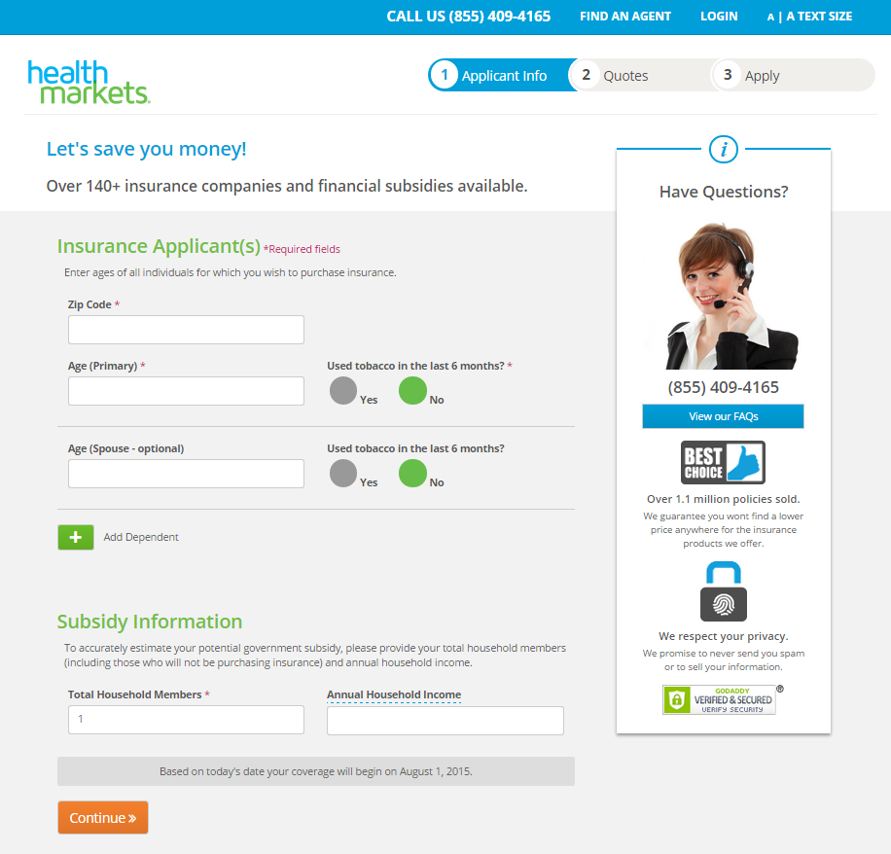

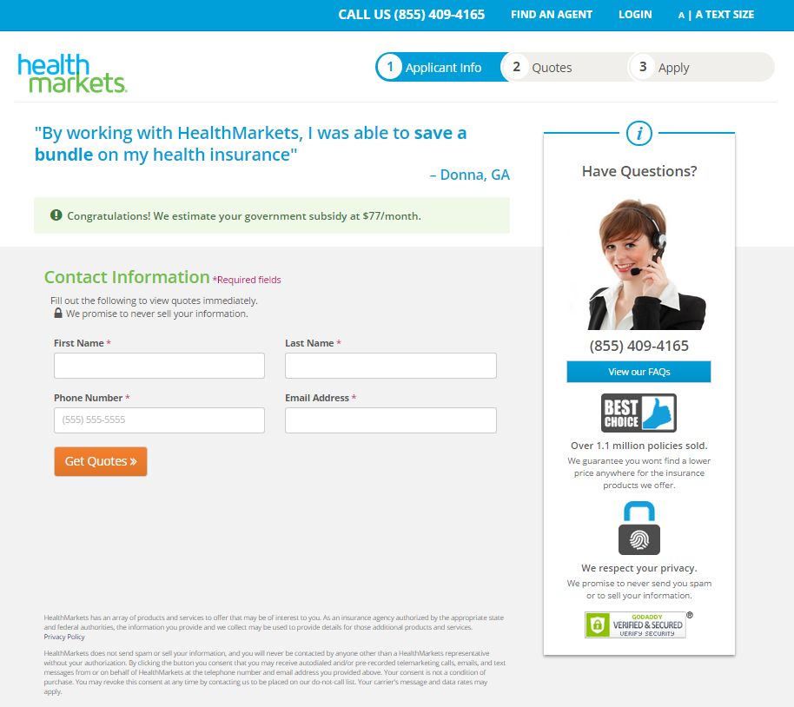
healthmarkets.com

Slide 9
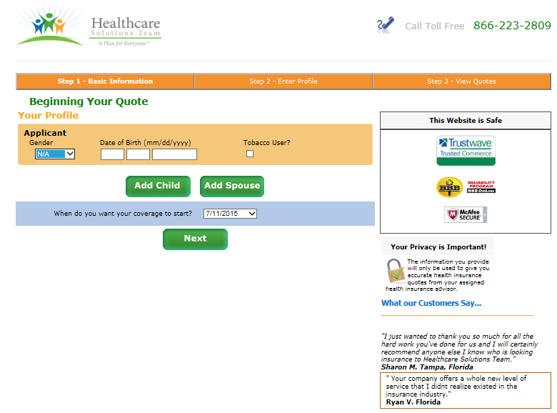
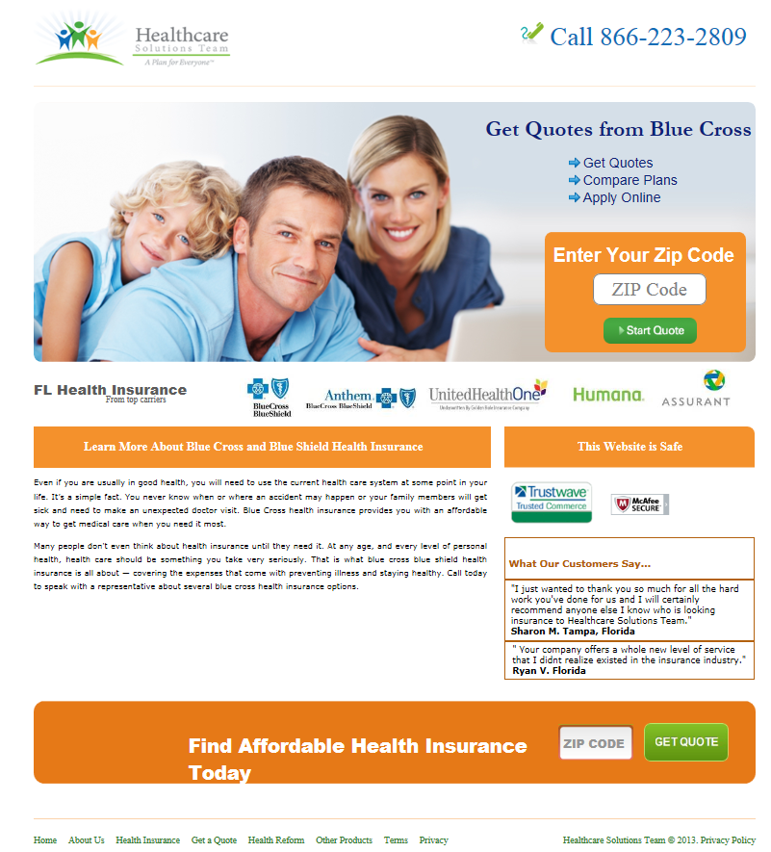
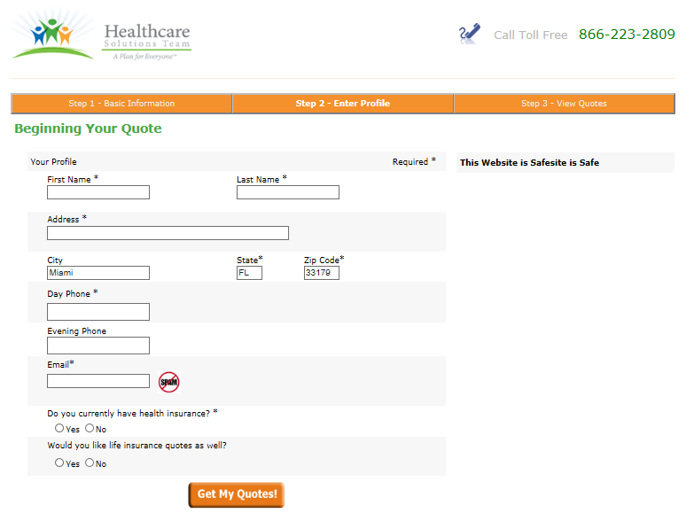
hstinsurancequotes.com

Slide 10
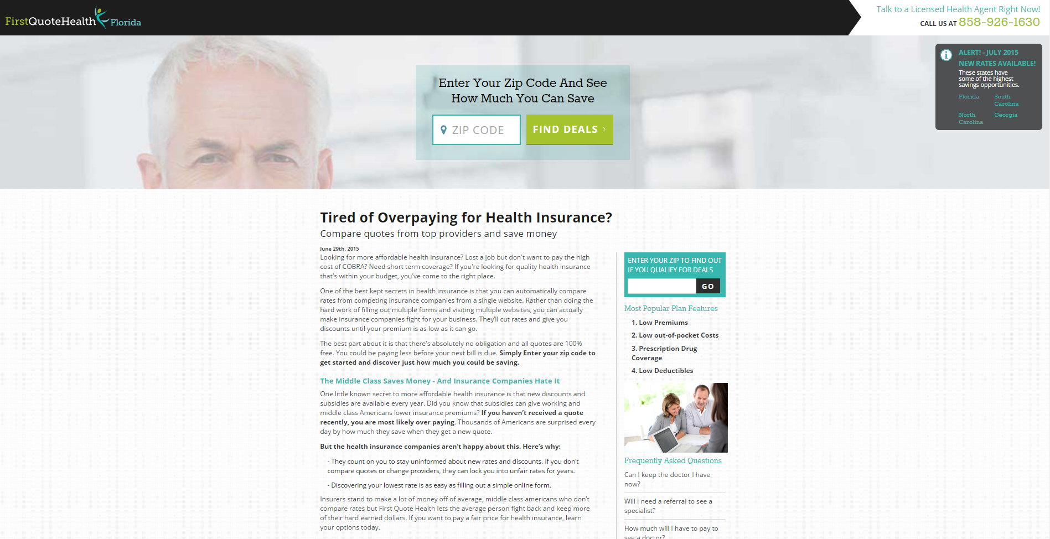
firstquotehealth.com

Slide 11


firstquotehealth.com

Slide 12
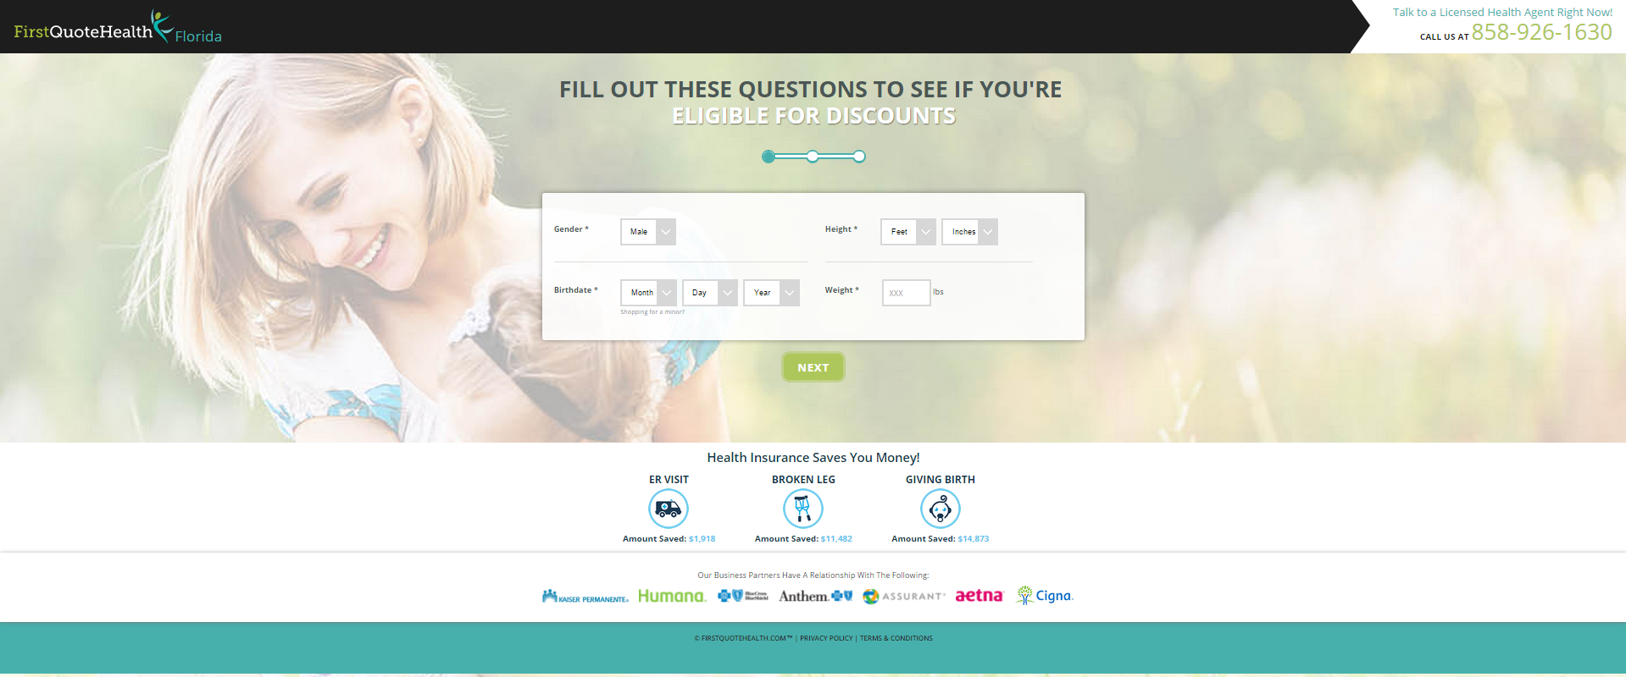
firstquotehealth.com

